Slide 1

McGraw-Hill Technology Education
Copyright © 2006 by The McGraw-Hill Companies, Inc. All rights reserved.

Slide 2
Chapter 13A
Creating Computer Programs

Slide 3

What Is a Computer Program?
Computer programs
  Also called software
  Are a list of instructions
  Instructions are called code
  CPU performs the instructions
  Three types
    Operating system
    Utility
    Application
Notes:
Teaching tip
Chapters 7 and 8 cover software in great detail.

Slide 4
Software Is Stored In Many Files
Executable files
  Contain the instructions for the CPU
  Have extensions of .exe, or .com
Notes:
Teaching tip
Open a folder and demonstrate each file. Show what happens when you open each file type.

Slide 5
Software Is Stored In Many Files
Dynamic link libraries
  Partial executable file
  Used to support executable files
  Have .dll extensions

Slide 6
Software Is Stored In Many Files
Initialization files
  Contain configuration settings for software
  Have a .ini extension
  Modern programs use the registry

Slide 7
Software Is Stored In Many Files
Help files
  Contain information about the software
  Information is indexed and searchable
  Provides an online manual
  Have a .chm or .hlp extension
Notes:
Teaching tip
Most Windows programs provide help by hitting the Help menu or pressing F1. This will open the Windows Help program and display the help appropriate to the application that launched the help.

Slide 8
Software Is Stored In Many Files
Batch files
  Used to automate tasks
  Hold a series of OS commands
  Have a .bat extension

Slide 9
Hardware/Software Interaction
Program execution
  Software executes at the CPU level
  Code to play a sound
    Code generates an interrupt
    CPU tells the sound card to play
    Sound card plays the file
  Programmer creates the code
Notes:
Discussion point
Page 501 states “Computers are the reason people purchase computers”. This is an excellent quote. Have students list all the things that they do with computers. When done, point out that the majority of items are handled by a software application.

Slide 10
Hardware/Software Interaction
Code
  Statements written in a programming language
  Writing code can be tedious
    Code must be perfect
    Order of steps must be exact
  Writing code is quite exciting
    Problems are solved
    New ideas are formed

Slide 11
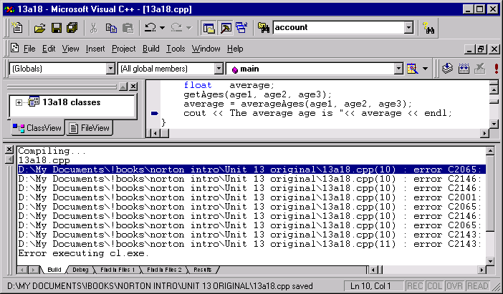
Writing Code

Slide 12
Hardware/Software Interaction
Machine code
  Recall that computers think in binary
  Code is translated into machine code
    CPU executes the machine code
  CPUs have a unique machine code
Notes:
Teaching tip
Figure 13A.4 on page 502 shows an example of binary code.

Slide 13
Hardware/Software Interaction
Programming languages
  Simplifies the writing of code
    English is used to describe the binary
  Original code is called source code
  Several hundred languages exist
Notes:
Teaching tip
It is a good idea to show a few different programming environments. In particular, show the same program (Hello World works well) in several different languages. Point out that the result is the same, but the syntax is very different.

Slide 14
Hardware/Software Interaction
Compilers and interpreters
  Converts source code into binary
    Allows code to execute
  Checks source code for correctness

Slide 15
Hardware/Software Interaction
Compiler
  Creates an executable file
    Contents are called object code
  Executable can run on its own
  Each language has its own compiler
  C++ and Java are compiled languages

Slide 16
Hardware/Software Interaction
Interpreter
  Runs program one line at a time
  More flexible than compilers
  Slower than compilers
  Always needed to execute program
  Visual Basic and Perl are interpreted

Slide 17
Planning a Computer Program
Plans
  The steps to solve a problem
  Describe the expected results
  Programming without a plan is difficult
Notes:
Teaching tip
Imagine driving from New York City to Los Angeles without a map, directions, cell phone or street signs. This is programming without a plan.

Slide 18
Planning Tools
Pseudo code
  Natural language statements that
  resemble code
  Describes what must be done
  Can be written by non programmers
  Programmers develop unique versions

Slide 19
Planning Tools
Input-processing-output (IPO) charts
  Determines what is needed
  Input column
    Data inputted by the user
  Processing column
    Pseudo code describing the problem solution
  Output column
    Desired output from the program

Slide 20
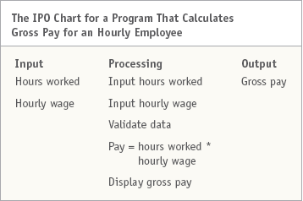
IPO Chart

Slide 21
How Programs Solve Problems
Program control flow
  Order program statements are executed
  Typically executed in order
  Constructs can change the flow
    Decision statements
    Loops
Notes:
Teaching tip
Briefly describe a loop and an if statement here.

Slide 22
How Programs Solve Problems
Algorithm
  Set of steps
  Always leads to a solution
  Steps are always the same
  Flowcharts can describe algorithms
    Structured tool for drawing algorithms
  Algorithms appear in all programs
Notes:
Teaching tip
Figure 13A.8 on page 505 shows a flowchart.

Slide 23
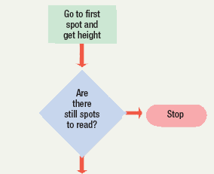
Flowchart

Slide 24
How Programs Solve Problems
Heuristic
  Set of steps
  Solution is usually found
  Solution may not be optimal
  Used when algorithms fail
    Algorithm is nonexistent or too complex
  Appear in more complex applications
    Data mining
    Anti-virus software
Notes:
Teaching tip
Data mining was introduced in chapter 11B.

Slide 25
Structured Programming
Programming using defined structures
Creates easy to read code
Programs are efficient and run fast
Several defined structures
Notes:
Teaching tip
While lecturing, have a sample program open that incorporates all of the followings structures.

Slide 26
Structured Programming
Sequence structure
  Describes the flow of the program
  Typically executed in order
  Branching statements allow multiple flows

Slide 27
Structured Programming
Selection statement
  Also called conditional statement
  Performs a true or false test
  Determines which code to execute next
Notes:
Teaching tip
Driving a car provides several examples of selection statements. The selection statements for an intersection with a traffic light provide three statements for discussion.

Slide 28
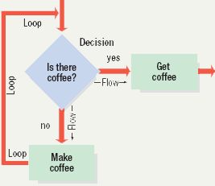
Structured Programming
Repetition statements
  Also called looping structures
  Repeats a section of code
    Until an exit condition is reached
Notes:
Teaching tip
Discuss the algorithm for walking up a flight of stairs. It becomes apparent that a loop is needed in the algorithm. The loop exits at the top of the stairs.

Slide 29
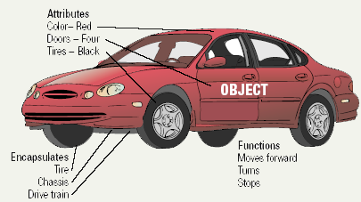
Object Oriented Programming
Also known as OOP
Enhances structured programming
Intuitive method of programming

Slide 30
Object Oriented Programming
Code reuse
  Code used in many projects
  Speeds up program development
  Simplifies program development

Slide 31
Object Oriented Programming
Develops objects
  All real world items are objects
  OOP develops code versions
  Contains data about the item
  Contains functionality
  Object encapsulates both into one package
Notes:
Teaching tip
Provide an example of an object. I often use a lead pencil. Data includes the size and type of lead. Functionality includes write, erase, extendLead, extractLead and replenishLeadSupply.

Slide 32
Chapter 13A
End of Chapter

